Slide 1


Slide 2
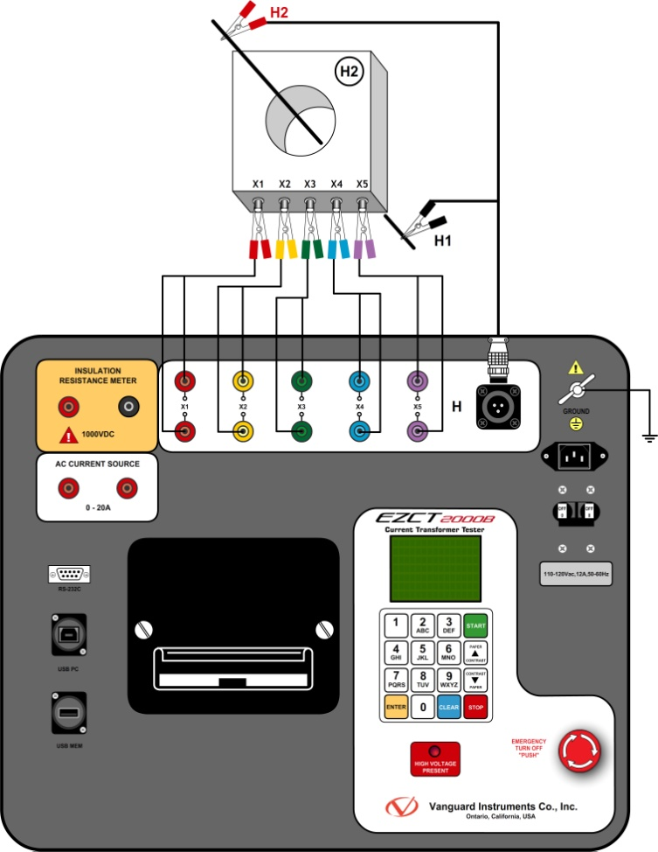
EZCT TURNS RATIO TEST
The EZCT’s use the “Voltage Method” to determine the CT Turns ratio
The ideal connection is shown in this illustration

Slide 3
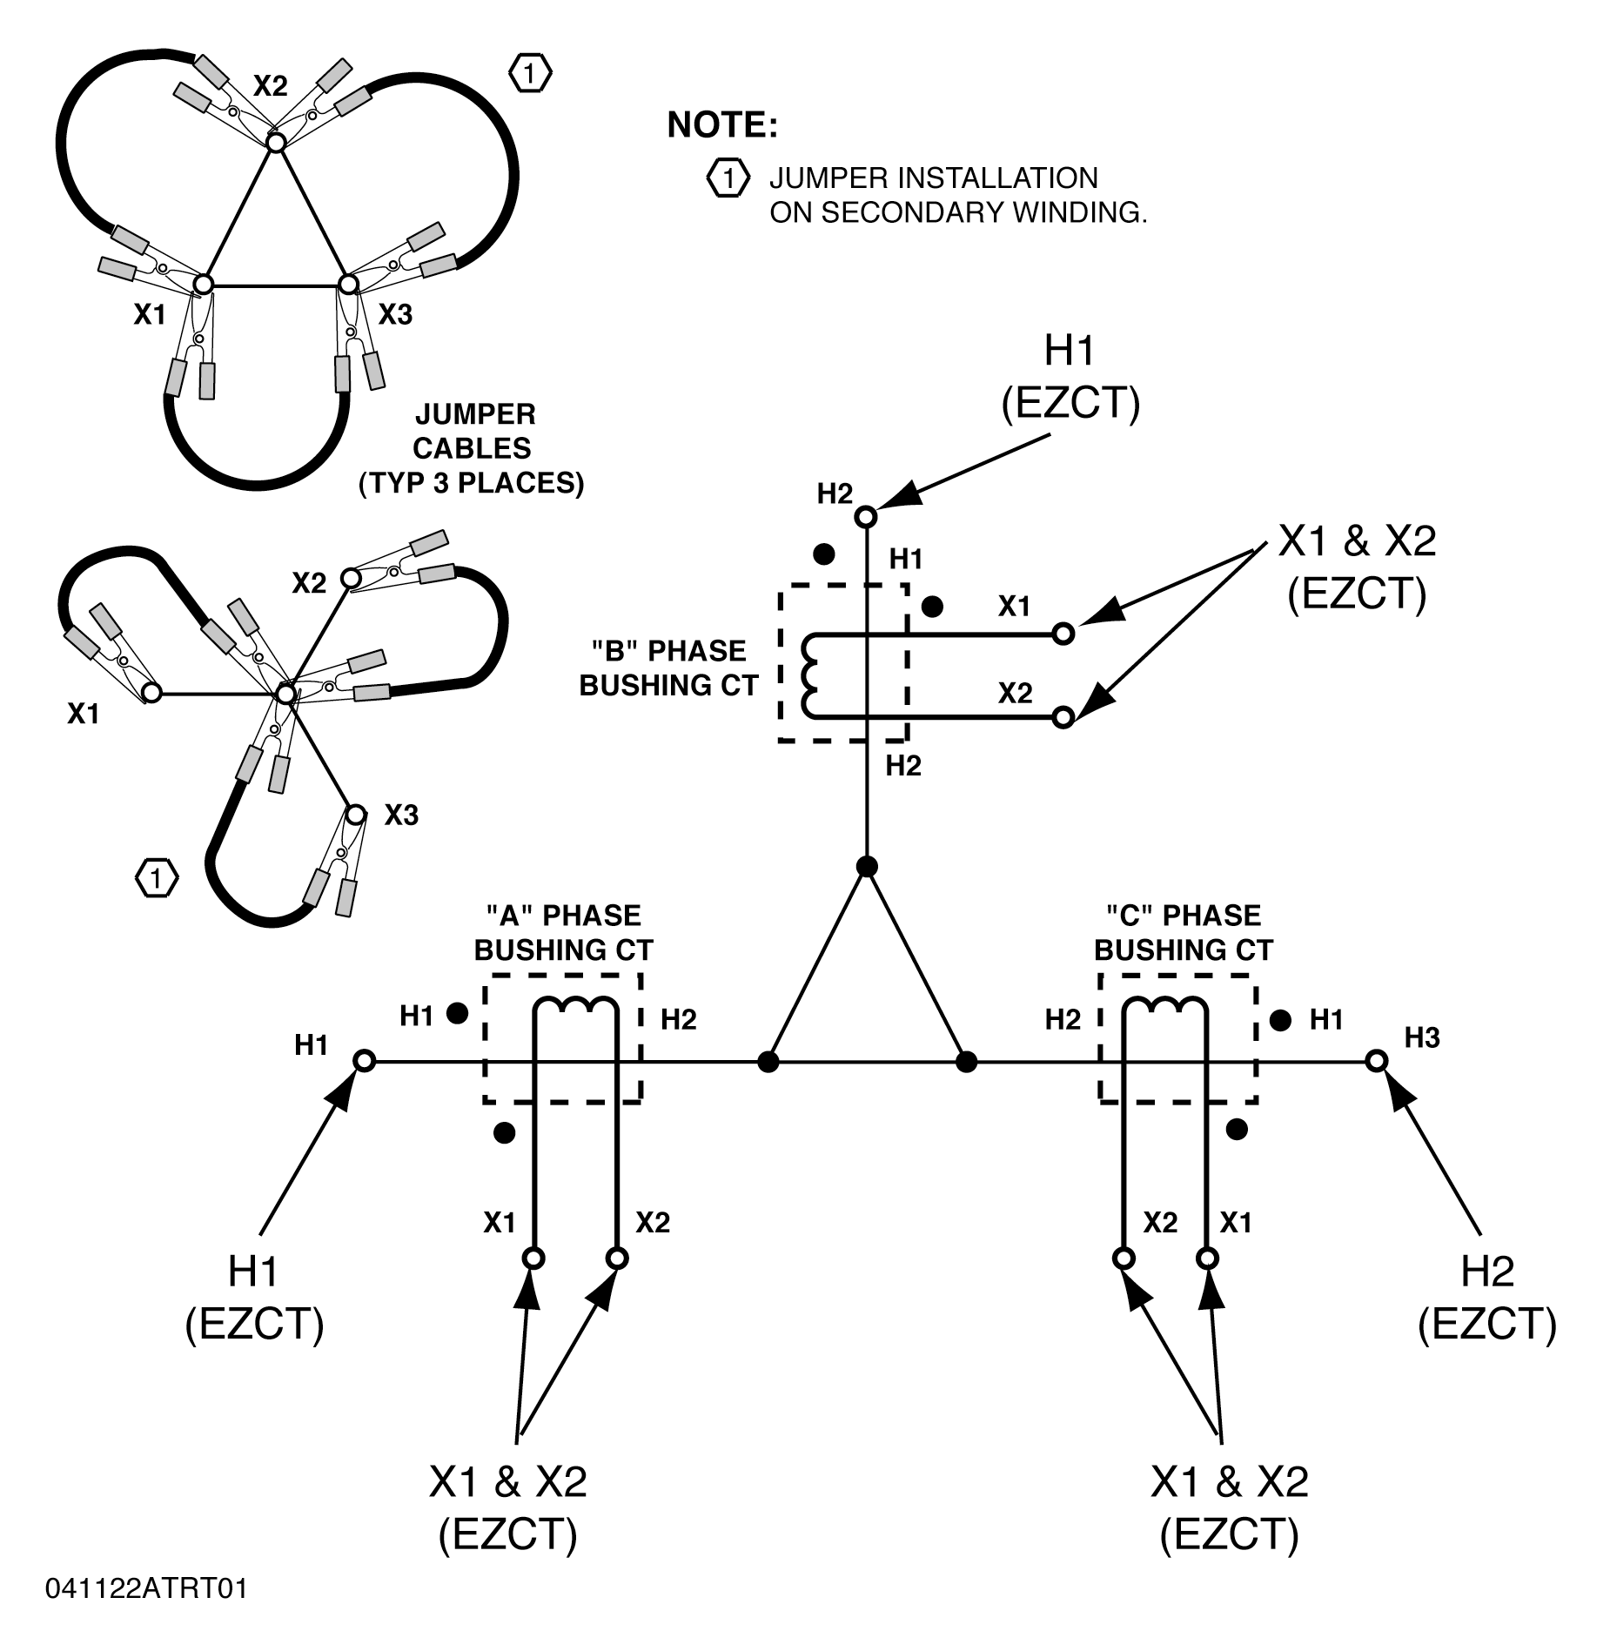
EZCT/EZCT-2000 TURNS RATIO TEST
When the CT’s are mounted on the transformer primary windings, the user needs to install jumpers on the secondary windings to eliminate the Turns-Ratio reading errors
Typical CT’s on the Delta windings is shown here
Secondary windings are shorted (X bushings are shorted)

Slide 4
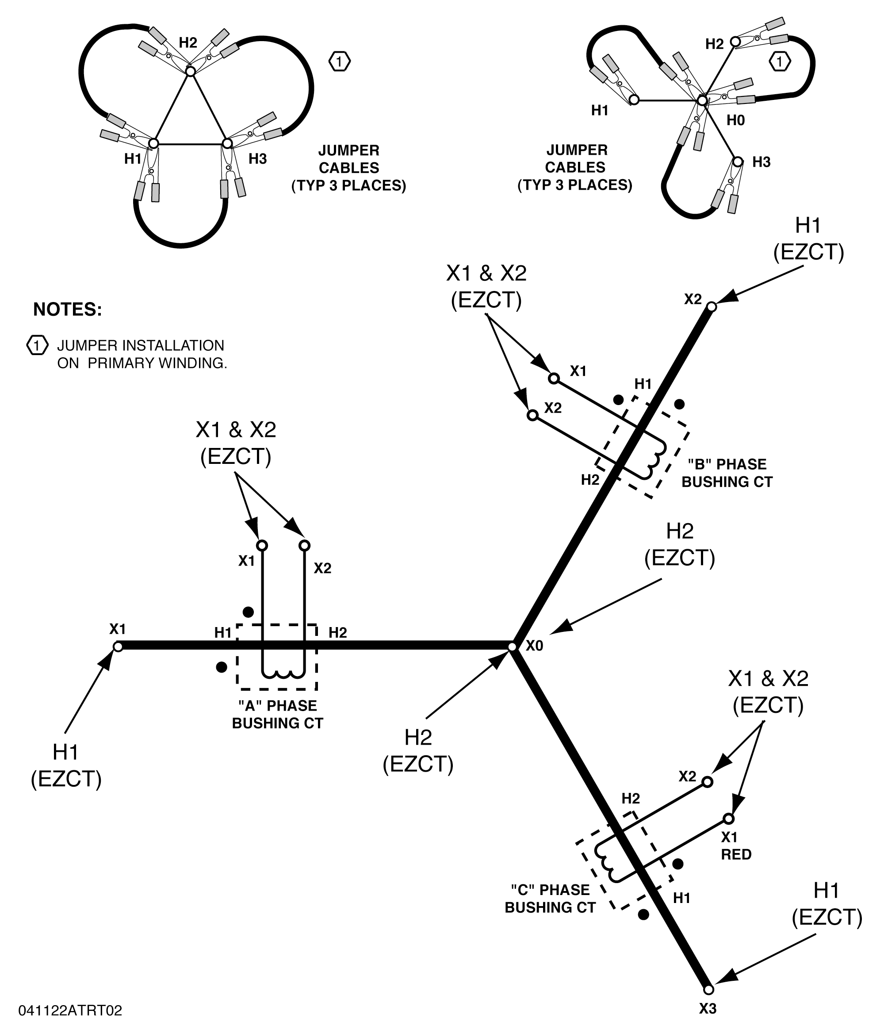
EZCT/EZCT-2000 TURNS RATIO TEST
When CT’s are mounted on the transformer secondary windings, the user needs to install jumpers on the primary windings to eliminate the Turns-Ratio reading errors
Typical CT’s on the Wye windings is shown here
Primary windings are shown shorted (H bushings are shorted)

Slide 5
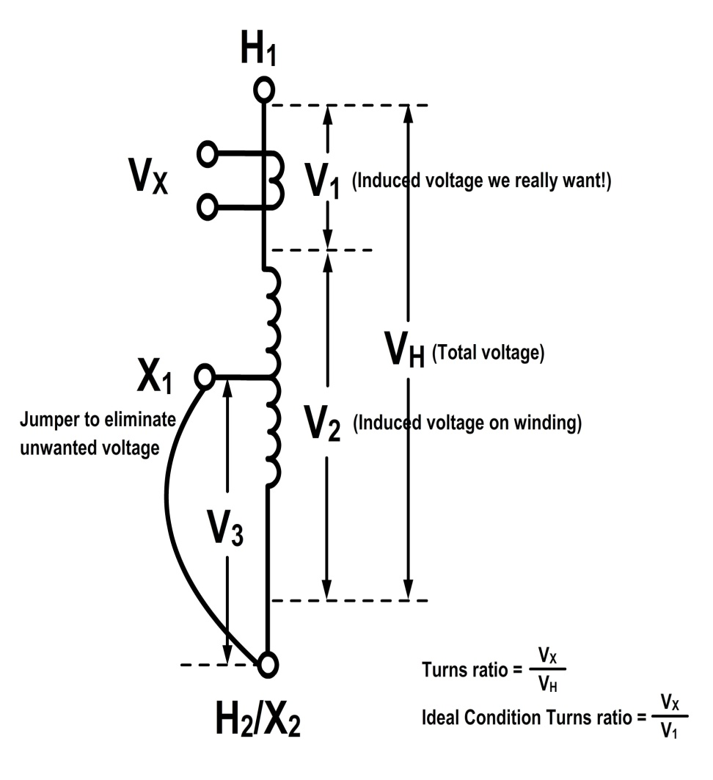
EZCT/EZCT-2000 TURNS RATIO TEST
A CT mounted on an Auto-Transformer presents an issue
External jumper will not eliminate all the unwanted induced voltage on the winding
The turns ratio will be off even with the jumper installed

Slide 6
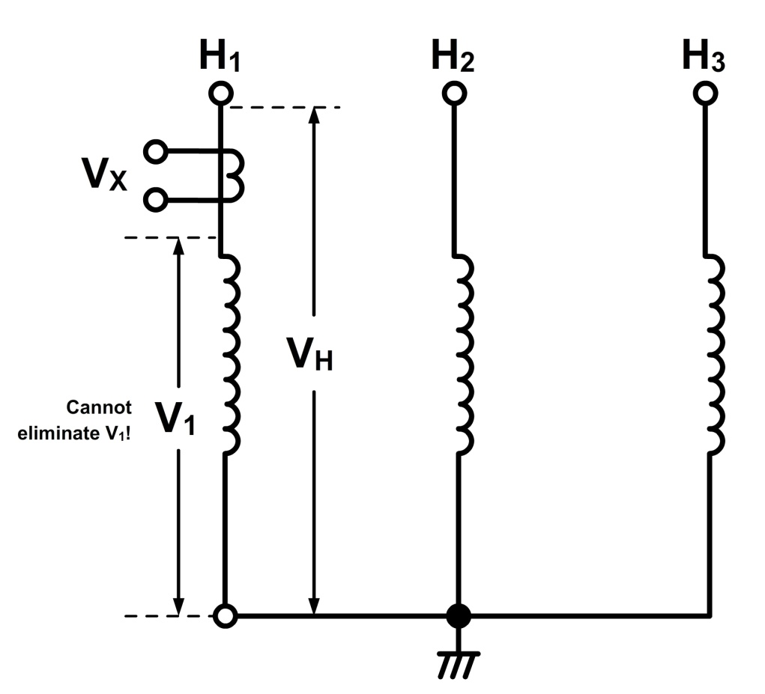
EZCT/EZCT-2000 TURNS RATIO TEST
A CT mounted on a reactor winding also creates a problem when the user wants to measure the turns ratio
Since there is no secondary winding that can be shorted to eliminate unwanted voltage (V1), the reading will be off
If the CT is accessible, the user can run a conductor through the center of the CT to measure the induced voltage to correct the problem

Slide 7
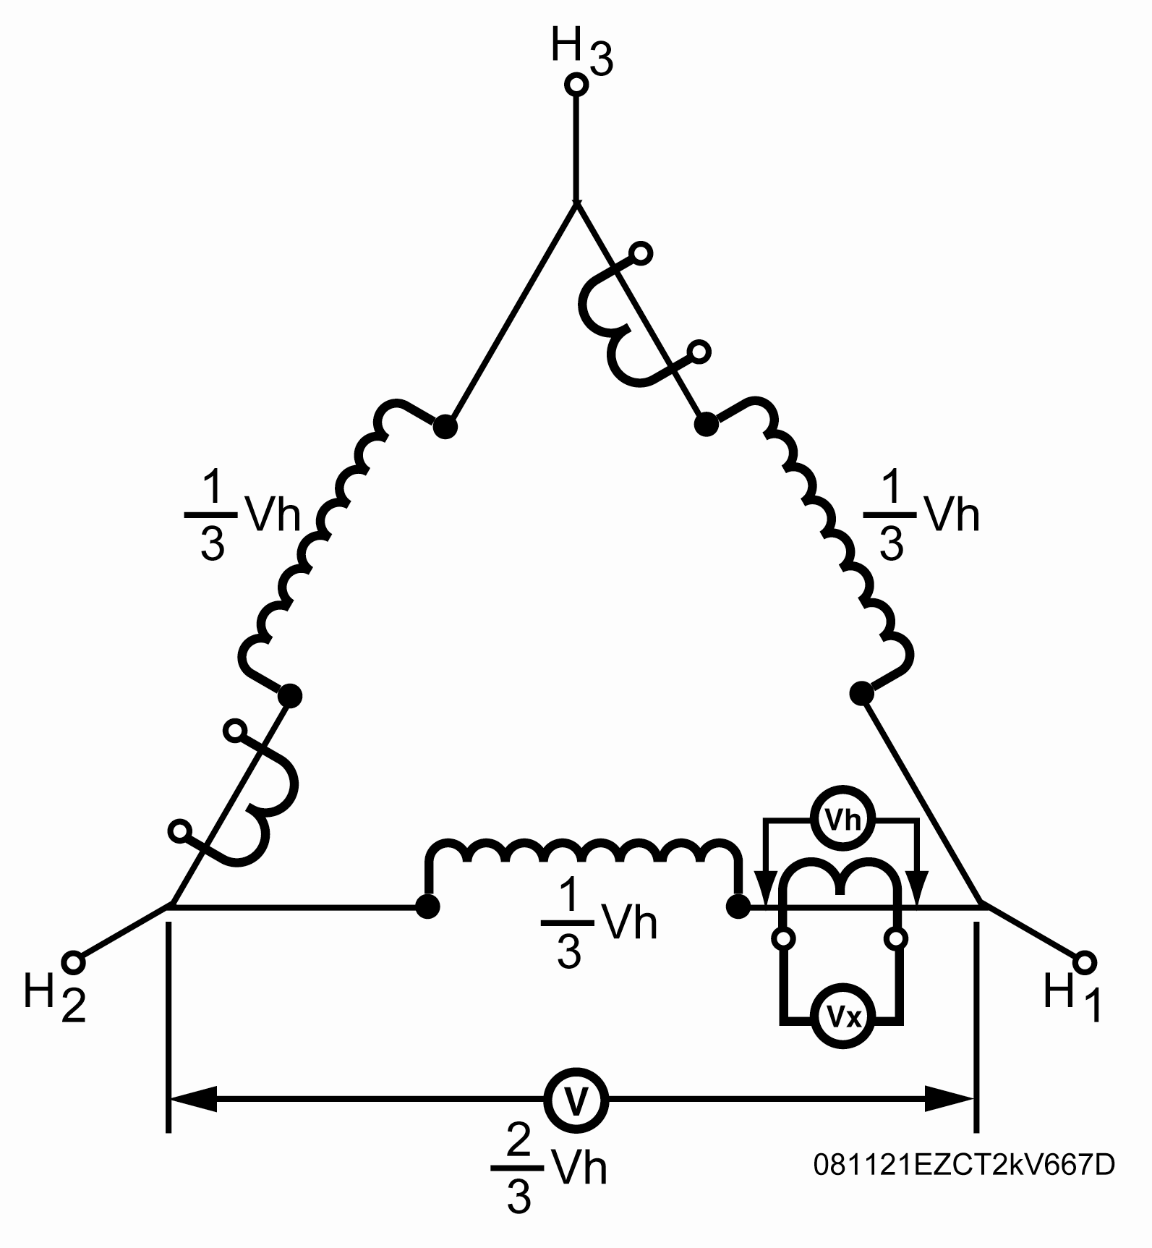
EZCT/EZCT-2000 TURNS RATIO TEST
Buried CT’s inside a Delta winding turns ratio is measured at 3/2 of its nameplate value using the voltage method
The CT turns ratio is ideally measured as: Ratio = Vx/Vh

Slide 8
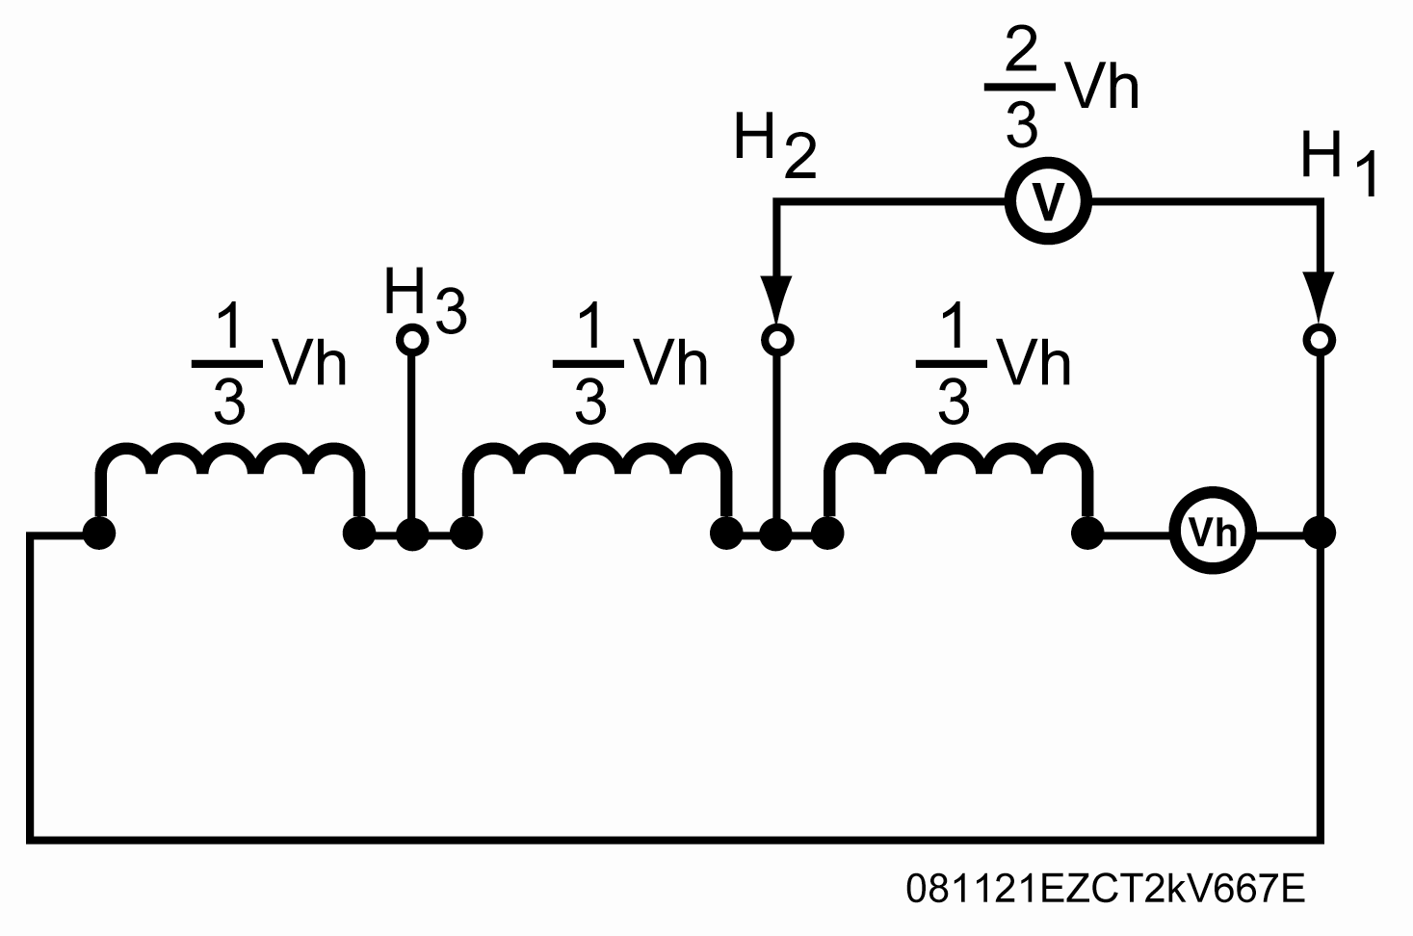
EZCT/EZCT-2000 TURNS RATIO TEST
Since the induced voltage (V) is sensed through the H1-H2 terminals of the Delta winding, this induced voltage is measured as V = (2/3 ) Vh
The CT turns ratio is now measured as Ratio =Vx/V or Ratio = (3/2 )(Vx/Vh ). This measured turns ratio is (3/2) higher than the actual turns ratio
The EZCT-2000B will display the correct CT turns ratio by adjusting the measured turns ratio by 2/3 when the user select the “Buried CT in Delta” mode

Slide 9
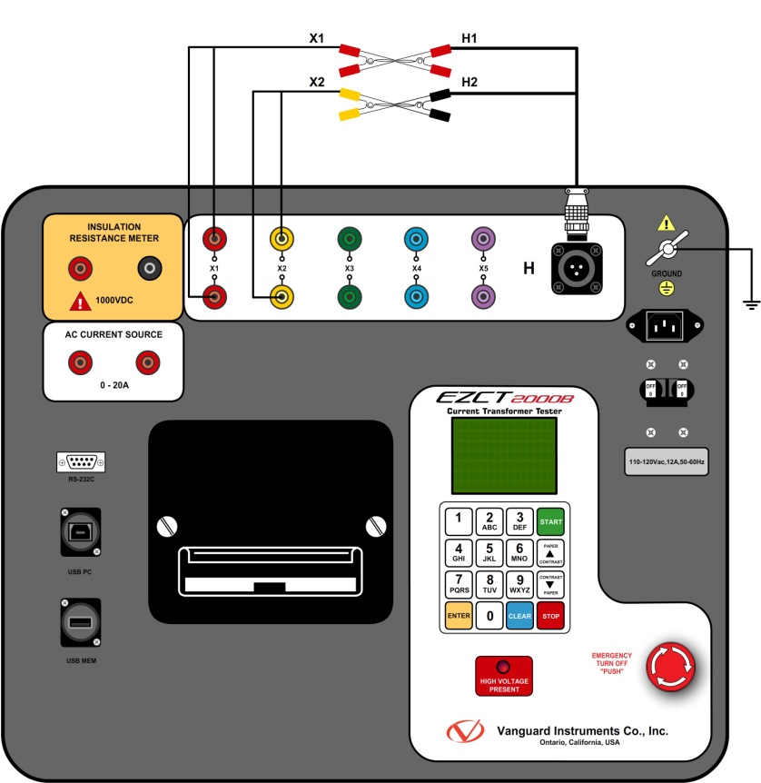
EZCT/EZCT-2000 TURNS RATIO TEST
To perform a self test on the EZCT/EZCT-2000:
Connect the H1 lead to the X1 lead
Connect the H2 lead to the X2 lead
Run ratio test only on the EZCT/EZCT-2000
Observe turns ratio display to be +1.000
Observe polarity to be in-phase
This test verifies the EZCT/EZCT-2000’s turns ratio circuitry

Slide 10
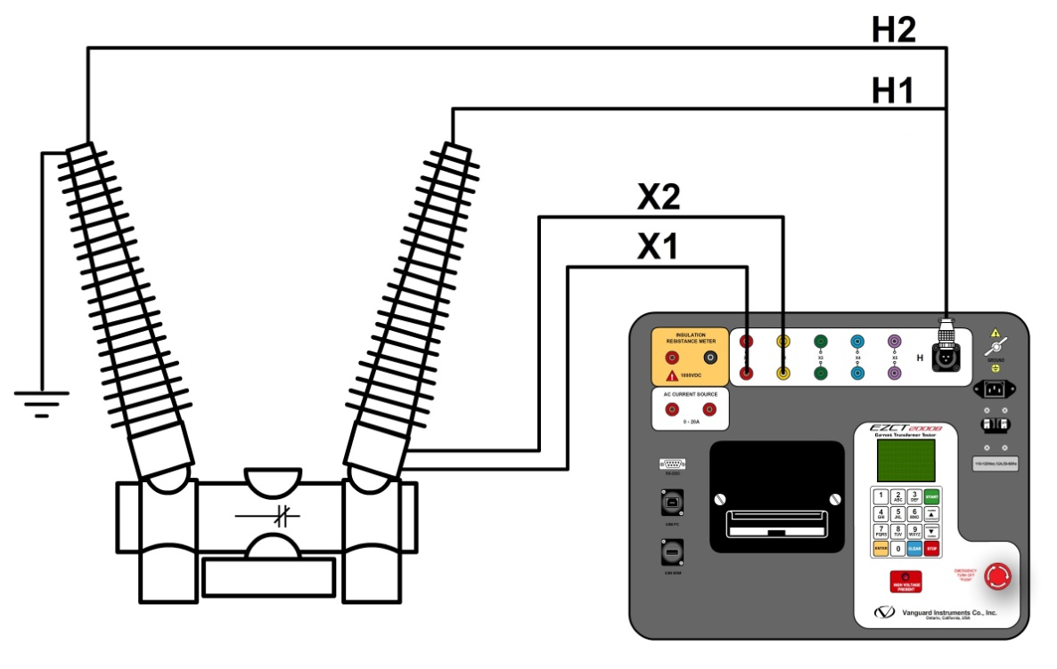
EZCT/EZCT-2000 TURNS RATIO TEST
If the turns ratio reading of CT’s on a CB is off:
Check for CB bushing being grounded on both sides
If one side of the CB bushing is grounded, make sure the EZCT H2 probe is on the grounded bushing
Check the physical location of the CB in the substation. If you are next to a HV line, your reading may be off

Slide 11
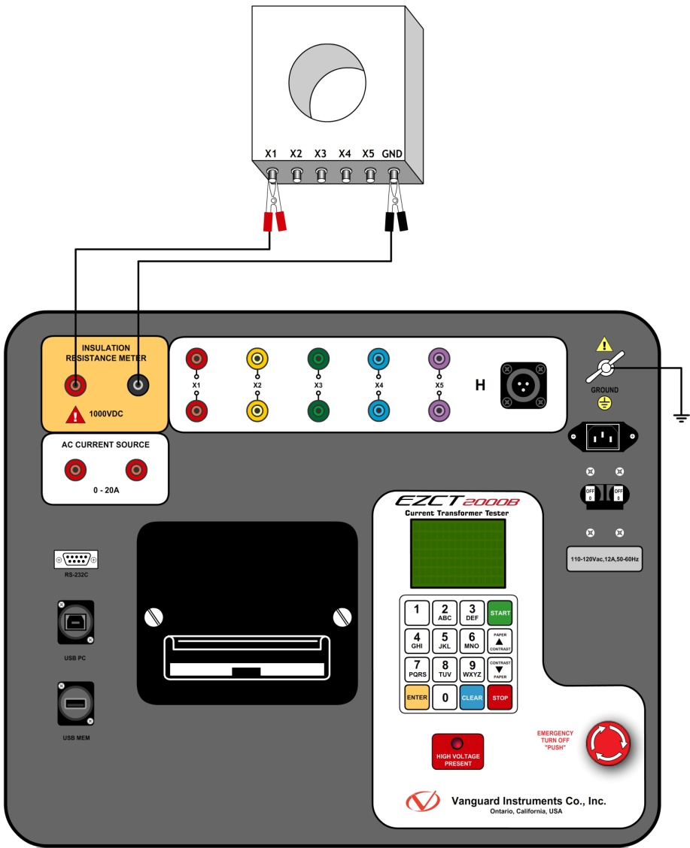
EZCT/EZCT-2000 INSULATION TEST
Insulation Test Connections:
Isolate all X terminals of the CT from EZCT/EZCT-2000
Connect “Positive” probe of the EZCT-2000B to any CT X terminal
Connect “Negative” probe to the CT ground terminal

Slide 12
EZCT/EZCT-2000 POWER SOURCE
EZCT/EZCT-2000 can be operated using an inverter
A Pure sine wave inverter output is recommended
A generator power source may affect the turns ratio and polarity reading readings due to the instability of the AC source.

